Slide 1


MEDICAL INVENTORY OPTIMIZATION
Medical inventory management is crucial for the many operation of
healthcare facilities. As the demand for healthcare services grows and
becomes more complex, the need for optimizing medical inventory
has never been more pressing. Healthcare establishments all over the
world need to handle their medical inventories effectively. Patient
care may suffer because of overstocking, stockouts, and higher
expenses brought on by inaccurate medication demand predictions.

Slide 2
Contents
Business Objective
Business Constraints
Project Architecture - Data Flow Diagram
Data Collection
Exploratory Data Analysis
Data Visualization
Notes:
Change

Slide 3
Business Problem
Business Problem: Bounce rate is increasing significantly leading to patient dissatisfaction.
Business Objective: Minimize Bounce Rate
Business Constraint: Minimize Inventory Cost
Business Success Criteria: Reduce bounce rate by at least 30%.
Economic Success Criteria: Increase revenue by at least 20 lac INR by reducing bounce rate.

Slide 4
Project Overview and Scope
The future scope of medical inventory optimization and bounce rate is to leverage data-driven approaches and advanced machine learning techniques to forecast drug demand, optimize inventory levels, and reduce waste and costs. Some of the benefits of this approach are:
Minimize drug shortages and stockouts, which can lead to improved patient care and satisfaction, as well as reduced bounce rate.
Maximize the availability and utilization of drugs, which can increase sales and profits, as well as customer loyalty and retention.
Reduce inventory costs and waste, which can improve cash flow and sustainability, as well as reduce the environmental impact of expired or unused drugs.

Slide 5
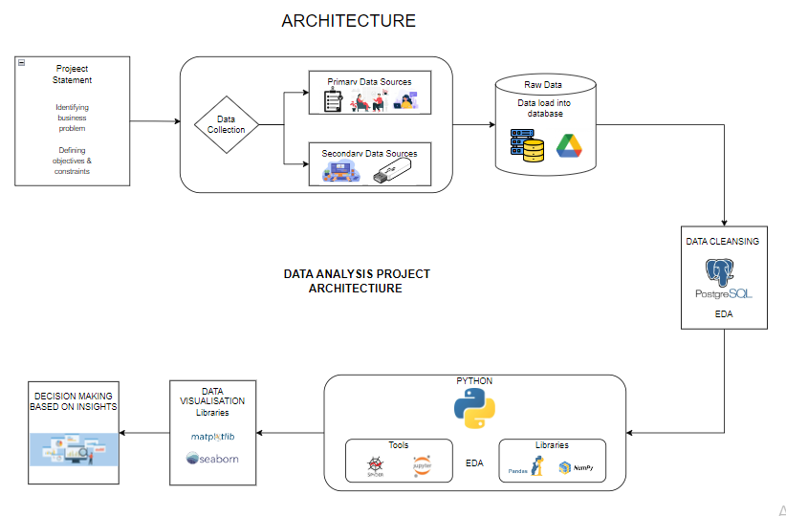
Project Overview and Scope
This project architecture defines the flow of project methodologies.
In this project we use Python and SQL for data preprpcessing.
In this project we identified business problem, objectives and business constraints.
We collected data from research article to provide better data analyzation.

Slide 6
Data Dictionary
There are in total 14 columns defining types of sales, patient ID, Specialization of Doctors, Department, Date of Bill, Quantity, Return Quantity, what is Final Cost and Final Sales of Drugs, MRP of returned Drug, Formulations and Subcategories.
Typeofsales: Type of sale of the drug. Either the drug is sold or returned. Typeofsales Type of sale of the drug. Either the drug is sold or returned.
Patient_ID: ID of a patient.
Specialisation: Name of Specialisation. (eg. Child specialist)
Dept: Pharmacy, the formulation is related with.
Dateofbill: Date of purchase of medicine.
Quantity: Quantity of the drug.
ReturnQuantity: Quantity of drug returned by patient to the pharmacy.
Final_Cost: Final Cost of the drug. (Quantity included)
Final_Sales: Final sales of drug.
RtnMRP: MRP of returned drug. (Quantity included)
Formulation Type of formulation.
DrugName: Generic name of the drug.
SubCat: Subcategory (Type) to the category of drugs.
SubCat1: Subcategory (condition) to the category of drugs

Slide 7
Exploratory Data Analysis [EDA]
Statistical Insights
Business Insights
Unprocessed data (secondary) involves noise in all four moment of business decision
Department 1 contains highest final cost, final sales, ReturnQuantity, RtnMRP.
Injections are highly in demand in subcat and subcat1
Final sales are more than final cost
ReturnQuantity are high than Quantity
Form 3 has more Null values.
Returnquantity, final sales and RtnMRP has 0 mode that means it contains more null values in counts
Injections are mostly used in medical inventory that means supply of injections is balanced.
Here most of medicines are returned as per the customer data and demands.
It is important to reduce bounce rate as it served best customer service.
Most of the frequent drugs are costly and less in demand.
As per the data, final sales are more that means many customers can be dissatisfied as they face medicine unavailability for certain conditions.
Notes:
EDA is used for seeing what the data can tell us before the modeling task.
Change

Slide 8
Exploratory Data Analysis [EDA]
 | Mean | Median | Mode | Variance | Standard Deviation | Range | Skewness | Kurtosis
Quantity | 1.879 | 1.0 | 1 | 12.401 | 3.521 | 150 | 17.078 | 463.54
ReturnQuantity | 0.238 | 0.0 | 0 | 0.817 | 0.904 | 20 | 7.8 | 97.1
Final_Cost | 132.872 | 54.292 | 42.464 | 243015.231 | 492.966 | 33138.0 | 32.73 | 1813.45
Final_Sales | 229.889 | 85.812 | 0.0 | 475084.669 | 689.264 | 39490.0 | 21.77 | 967.45
RtnMRP | 28.497 | 0.0 | 0.0 | 33075.687 | 181.867 | 8014.0 | 16.8 | 449.71
Notes:
Keep observations

Slide 9
Data Preprocessing
Data preprocessing is a data mining process which involves cleaning, transforming and integration of data to make data ready for analyzing. The goal of data preprocessing is to improve quality of data.
Here, Data preprocessing takes with two approaches. Python programming and Structured Query Language (SQL) programming.
Data cleaning steps include dealing with missing values, handling duplicate data, and finally removing outliers.
After cleaning, data is imported or load in a suitable manner i.e.(Excel or .CSV) for further steps.
Data transformation is used to standardize data, this includes formatting structure from unstructured data.
After data transformation, data enrichment steps were taken in a count to perform feature engineering.
After all this data is processed to make a machine learning model.
After data transformations, data is send to go through EDA (Exploratory Data Analysis).
Notes:
Keep observations

Slide 10
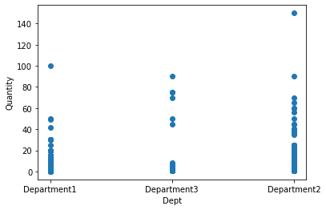
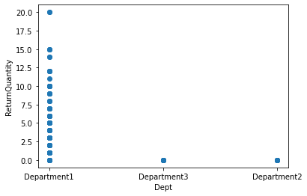
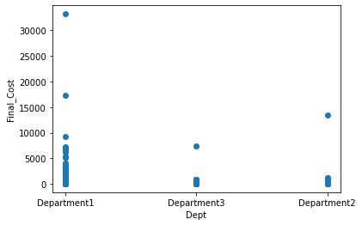
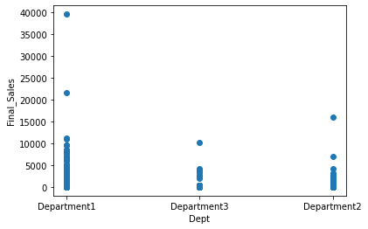
Data Visualization
Data Visualization plays important role in analyzing data. It represents data through graphs such as pie charts, scatterplots, line charts, bar graphs etc. It is used to evaluate relationships between data variables.
Here, Data visualization is performed with python programming using various python libraries such as pandas, numpy, matplotlib, seaborn etc.
Graph presented below represents relation of dept with quantities, return quantites, final cost and final sales.
It shows that in department 1 quantity, return quantity, final cost and final sales are more that other departments.
Notes:
Add graphical

Slide 11
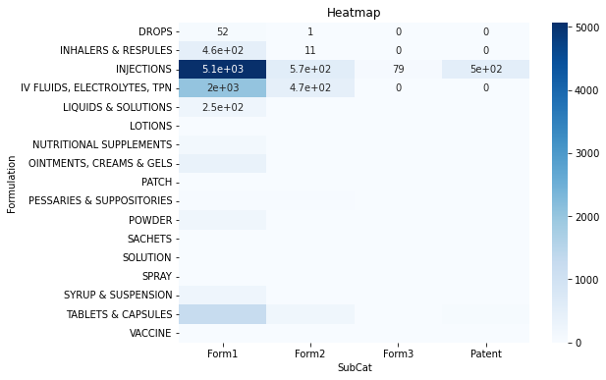
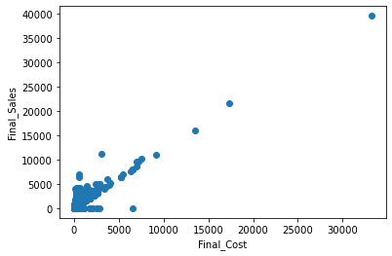
Data Visualization
Plotting of the two important categorical data formulation and subcat1 (subcategory 1) of the total outcomes using Heatmap (a picture or chart that shows the variations in temperature or infrared radiation that were observed over a certain area or over a certain amount of time).
Plotting two correlated (df.corr()) numerical data, Final_Sales and Final_Cost shows unique values between two variables.

Slide 12


